Slide 1
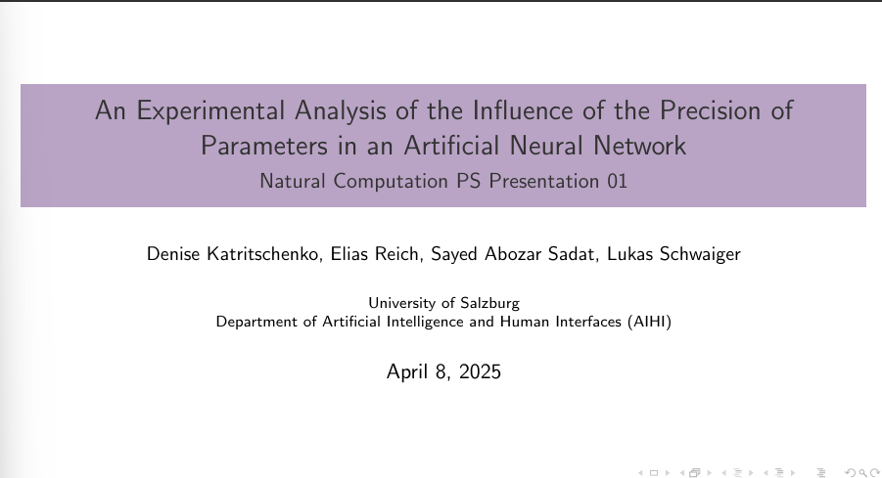

Slide 2
Recap and Today
What we are did: Change parameters precision of ANN
Look at the effects of
lower precision in training and inference.
lower precision only in inference.

Slide 3
Recap and Today
What we are doing: Using AMP with gradients to observe the accuracy of precision types.
This presentation:
Global Norm Gradient
Affect of Gradient on accuracy, training and testing timings.
Gradient Value Clipping
Affect of different Gradients on precision FP16 & Fp32.

Slide 4
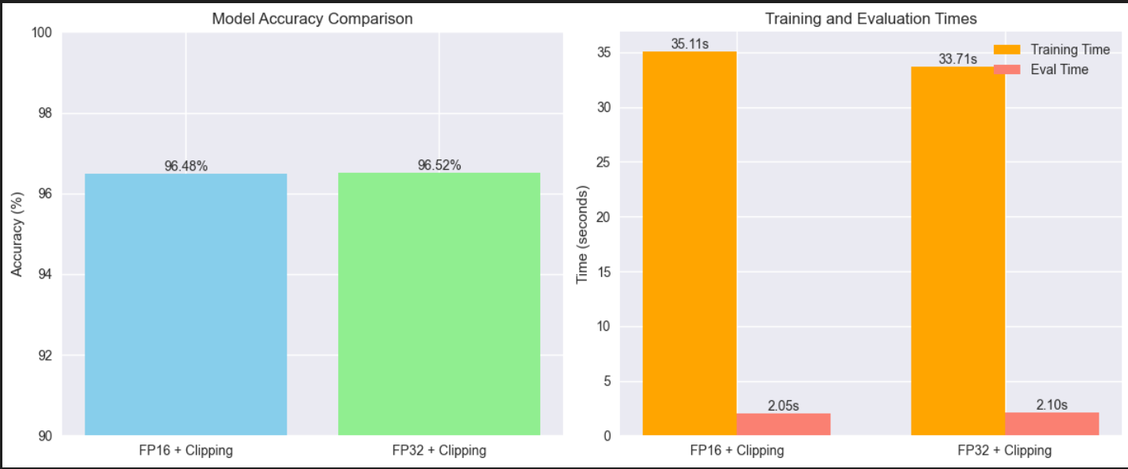

Slide 5
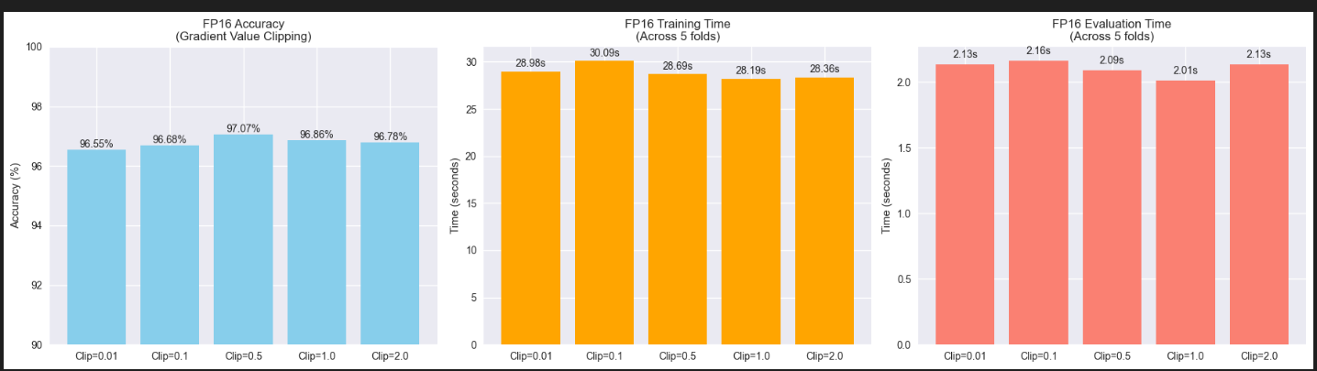

Slide 6
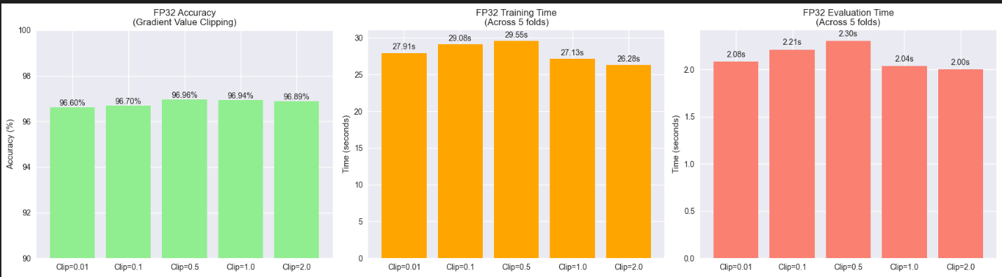

Slide 7
Interpretations:
Simple task and simple network → almost no effects.
Using Mixed precision FP16 and Fp32 with global gradient norm almost not change.
Using gradient value clipping there are also small changes.

Slide 8
https://docs.pytorch.org/docs/stable/generated/torch.nn.utils.clip_grad_norm_.html On the difficulty of training Recurrent Neural Networks https://arxiv.org/abs/1211.5063 Mixed Precision Training https://arxiv.org/abs/1710.03740
References

